Slide 1
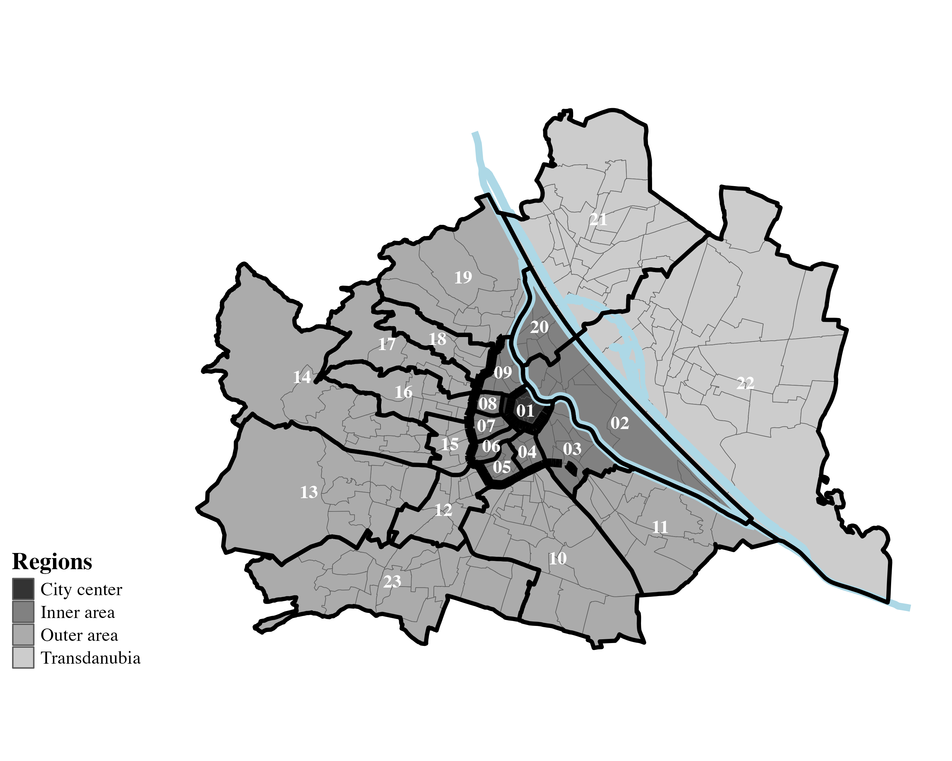

newest version for manuscript
Danube river
Gürtel
Danube canal
Ring

Slide 2
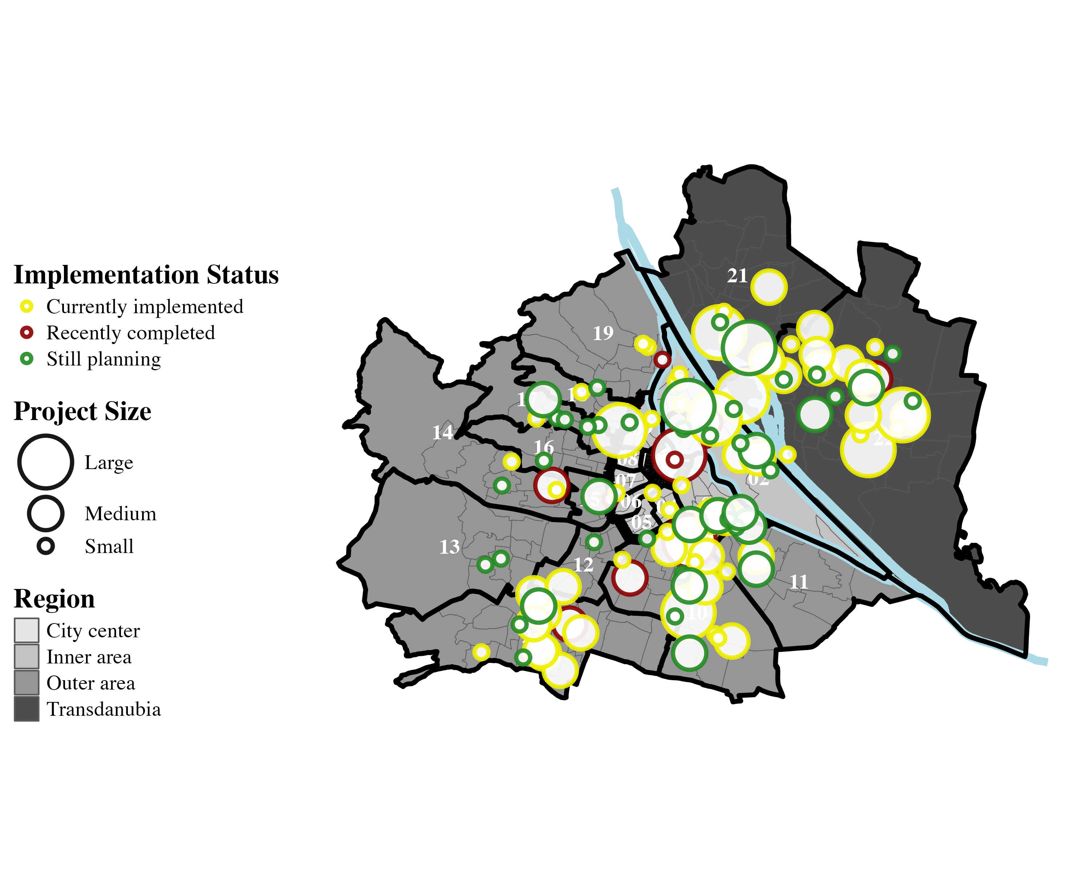
newest version for supplementary material
Danube river
Gürtel
Danube canal
Ring

Slide 3
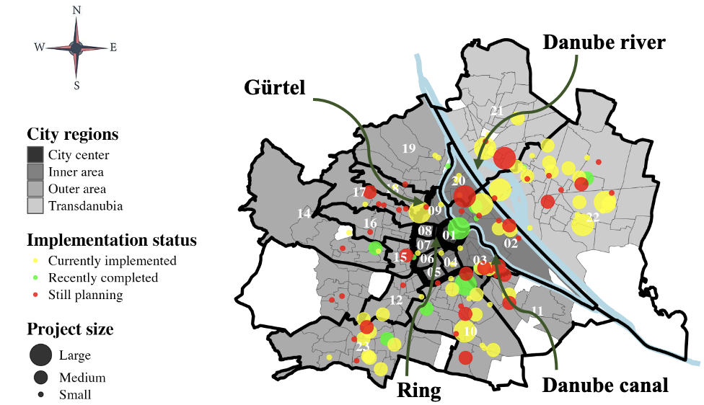

Slide 4
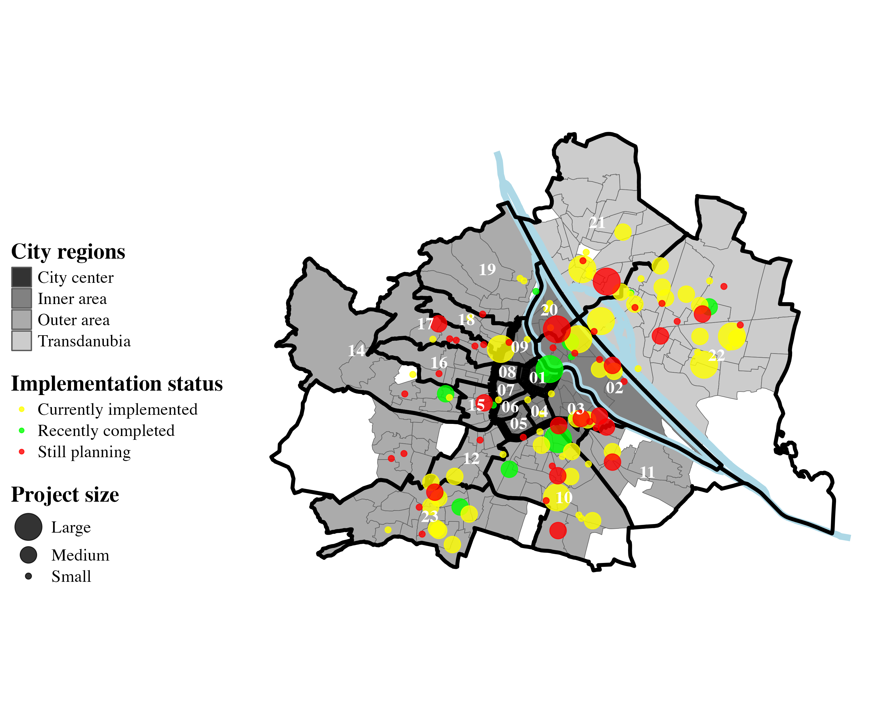
Danube river
Gürtel
Ring
Danube canal

Slide 5
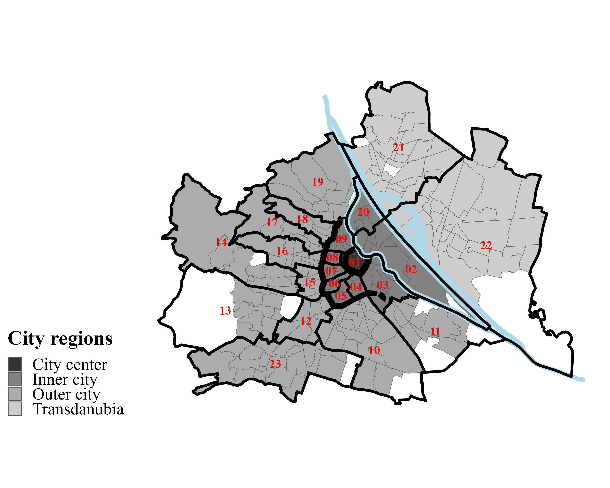
old version
Danube river
Gürtel
Danube canal
Ring

Slide 6
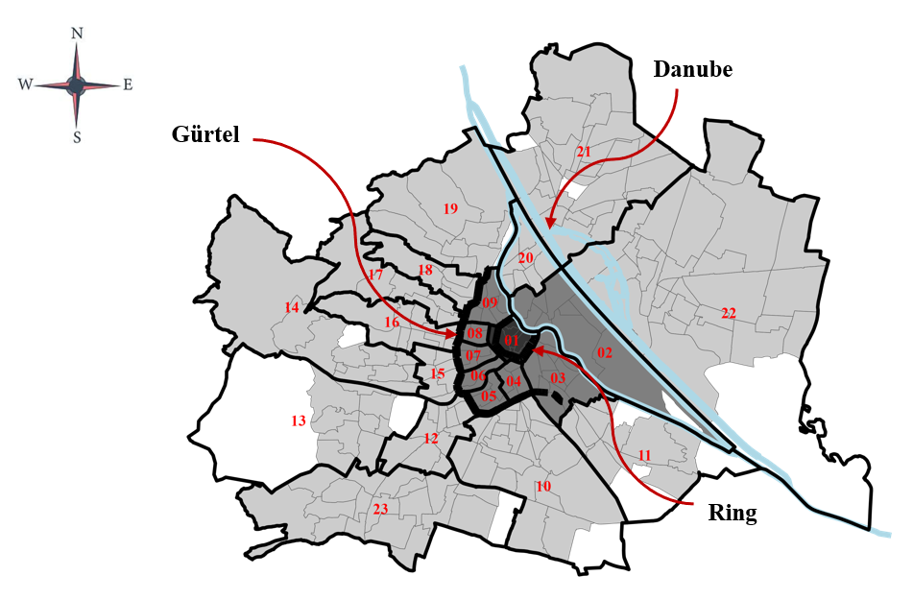
Oldest version

